Slide 1
Shell Scripts

Slide 2
What is a Shell Script?
A shell script is a file containing a series of commands
The shell reads this file and carries out the commands as if they have been entered directly on the command line
The shell is distinctive, in that it is both a powerful command-line interface to the system and a scripting language interpreter

Slide 3
Redirection using Pipe
echo “5/2” | bc
echo “scale=2; 5/2” | bc
echo “scale=10; 5/2” | bc

Slide 4
Redirection using >
name=“Linux Student”
echo $name > out.txt

Slide 5
PS Variables
Prompt Statement Environment Variables
PS1: Default interaction prompt
PS2: Continuation interaction prompt
PS3: Prompt used by the select statement inside a script

Slide 6
PS1: Default Interaction Prompt
Try this command: export PS1="\u@\h \w> “
The default prompt will be changed to show the user name, home, and working directory
export PS1="\u\w:\d-\t>"
PS1="\$(date +%d.%m.%Y) > "
export PS1
PS1="\D{%F %T}>“
export PS1="\u@\h [\$(date +%k:%M:%S)]> "

Slide 7
PS2
When you issue a command that is incomplete, the shell will display a secondary prompt and wait for you to complete the command and hit Enter again. The default secondary prompt is > (the greater than sign), but can be changed by re-defining the PS2 shell variable.
Before using PS2 …
echo “this is a
> test”

Slide 8
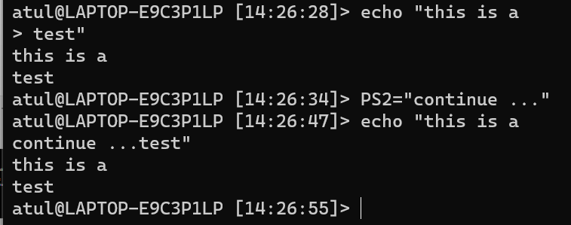
PS2
After using PS2 …
PS2=“continue …”
echo “this is a
continue... test”

Slide 9

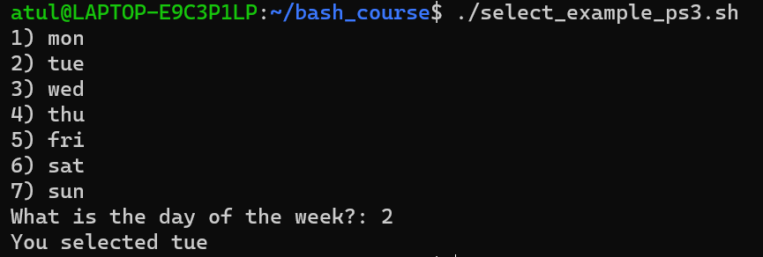
The select Command and the PS3 (Prompt for Select command) Variable
Called ‘Shebang’ or ‘Shabang’ operator, because:
# means sharp (as in C#)
! In comics is used as Bang!
select_example_ps3.sh
#!/bin/bash
PS3="What is the day of the week?: "
select day in mon tue wed thu fri sat sun;
do
echo "You selected $day"
break
done

Slide 10
Variables
A variable allows us to store useful data under convenient names
User-defined variables
Shell variables

Slide 11
User-defined Variables
Example
INSTITUTE=“ACTS”
echo “Hello $INSTITUTE”

Slide 12
Variable Examples – Note the Difference
#!/bin/bash
COUNT=5
echo “count = $COUNT”
echo We have $COUNT oranges
#!/bin/bash
COUNT=5
COUNT = 6
echo “count = $COUNT”
echo We have $COUNT oranges

Slide 13
Variable Examples – Strings and Spaces
#!/bin/bash
MESSAGE=Hello
echo “I want to say: $MESSAGE”
#!/bin/bash
MESSAGE=Hello there
echo “I want to say: $MESSAGE”
#!/bin/bash
MESSAGE=“Hello there”
echo “I want to say: $MESSAGE”

Slide 14
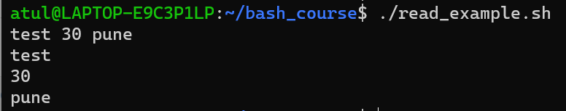
Reading Multiple Inputs in User Variables
read_example.sh
#!/bin/bash
read name age city
echo $name
echo $age
echo $city

Slide 15
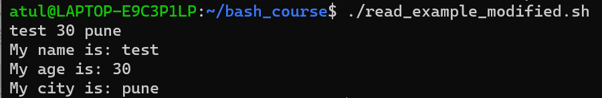
Reading Multiple Inputs in User Variables – Better Formatted
read_example_modified.sh
#!/bin/bash
read name age city
echo "My name is: $name"
echo "My age is: $age"
echo "My city is: $city"

Slide 16
Using echo with read
#!/bin/bash
echo –n “Enter your age:”
read AGE
echo “Your age is $AGE”

Slide 17
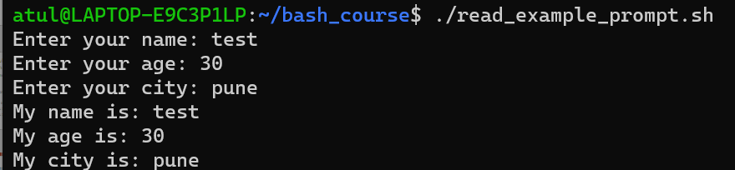
Adding Prompt to the read Command
Other useful options
-t: Timeout in seconds
-s: Secret
read_example_prompt.sh
#!/bin/bash
read -p "Enter your name: " name
read -p "Enter your age: " age
read -p "Enter your city: " city
echo "My name is: $name"
echo "My age is: $age"
echo "My city is: $city"

Slide 18
Wildcards
Wildcards help us create patterns for searching in shell commands
They are used to match text or string data
There are three main wildcard characters: * ? []

Slide 19
Wildcards
Character | Use | Example
Star or asterisk (*) | Search for specific characters 0 or more times | ls a* will search for all files in the current directory whose names start with a
Question mark (?) | Search for fixed number of characters, where one ? Represents one character | ls ???t.txt will search for all files in the current directory whose names are 4 characters long, end with t, and have an extension of txt
Square brackets ([]) | Match characters based on a range or in a group | ls hello.[t-z]* will search for all files in the current directory whose name is hello and extension is any number of any characters between t and z

Slide 20
Wildcard Examples
ls a* - List all files whose names start with a, file extension may or may not be there
ls a*.pqr - List all files whose names start with a, but file extension should be pqr
ls *.txt – Files that have extension txt
ls *.sh *.txt - Files that have extension txt or sh
ls Great*by.txt - Files whose name starts with Great, ends with by, and have extension txt
ls ?i* - Files whose names have i as the second character
ls *.??? – Files with any name, but exactly three characters in the extension
ls [sv]* - Files whose names begin with s or v
ls [s-v]* - Files whose names begin with any letter between s and v
ls *[0-9]* - Files whose names include at least one digit
ls [afgh]*o* - Files whose names start with a letter between and h and followed anywhere by letter o

Slide 21
Character Classes
We can use character classes to check for substrings or to do other comparisons
They are an alternative to the earlier wildcard syntax
Examples:
‘[:alpha:]’ instead of ‘[A-Za-z]’
‘[:lower:]’ instead of ‘[a-z]’
‘[:upper:]’ instead of ‘[A-Z]’
‘[:alphanum:]’ instead of ‘[0-9A-Za-z]’
‘[:digit:]’ instead of ‘[0-9]’
Note: If we are using these in bash commands, we need two square brackets – See next slide

Slide 22
Using Character Classes in Shell Commands
ls [:upper:]*.* - Will match any files that contain characters u p p e r in the file name – NOT WHAT WE WANT
We should write it as: ls [[:upper:]]*.*
Now we will get files whose names contain at least one upper case character

Slide 23
Regular Expressions
Wildcards and character codes can be used in regular expressions
Regular expressions allow us to check sub-strings, do exact string comparisons, etc
We will discuss this during Shell programming

Slide 24
Session 3: Shell Programming

Slide 25
Linux Editors
vi – The original Linux editor
vim – Improved version of vi
nano – Easy to work with (To install: sudo apt-get update and then sudo apt-get install nano)

Slide 26
Conditions – if Statement
#!/bin/sh
a=10
b=20
if [ $a -eq $b ]
then
echo “a is equal to b”
fi
if [ $a -ne $b ]
then
echo “a is not equal to b”
fi

Slide 27
Same Example using if-else
#!/bin/sh
a=10
b=20
if [ $a -eq $b ]
then
echo “a is equal to b”
else
echo “a is not equal to b”
fi

Slide 28
Check If a Number is Even or Odd
#!/bin/bash
read -p "Enter a number : " n
rem=$(( $n % 2 ))
if [ $rem -eq 0 ]
then
echo "$n is even number"
else
echo "$n is odd number"
fi

Slide 29
if-elif-else
#!/bin/bash
echo "Enter a Number"
read num
if [ $num -lt 0 ]
then
echo "Negative"
elif [ $num -gt 0 ]
then
echo "Positive"
else
echo "Neither Positive Nor Negative"
fi

Slide 30
Max of three numbers
#!/bin/bash
echo "Enter Num1"
read num1
echo "Enter Num2"
read num2
echo "Enter Num3"
read num3
# To accept multiple inputs: read num1 num2 num3
if [ $num1 -gt $num2 ] && [ $num1 -gt $num3 ]
then
echo $num1
elif [ $num2 -gt $num1 ] && [ $num2 -gt $num3 ]
then
echo $num2
else
echo $num3
fi

Slide 31
String Comparison
#!/bin/bash
# Shell script to check whether two
# input strings is equal
# take user input
echo "Enter string a : "
read a
echo "Enter string b : "
read b
# check equality of input
if [ "$a" = "$b" ]; then
# if equal print equal
echo "Strings are equal."
else
# if not equal
echo "Strings are not equal."
fi

Slide 32
Simple Calculator
#!/bin/bash
echo "A Simple Integer Calculator ..."
read -p "Enter the first number: " num1
read -p "Enter the first number: " num2
read -p "Enter the mathematical operator (+ - * / %): " operator
echo -n "You entered $num1 $operator $num2 and its result is "
if [ "$operator" = "+" ]; then
result=$(( num1 + num2 ))
elif [ "$operator" = "-" ]; then
result=$(( num1 - num2 ))
elif [ "$operator" = "*" ]; then
result=$(( num1 * num2 ))
elif [ "$operator" = "/" ]; then
result=$(( num1 / num2 ))
elif [ "$operator" = "%" ]; then
result=$(( num1 % num2 ))
else
result="undefined"
fi
echo $result

Slide 33
Salary Calculator
Write a shell script that computes the gross salary of an employee according to the following rules:
If basic salary is < 1500 then HRA = 10% of the basic and DA = 90% of the basic.
If basic salary is >= 1500 then HRA = Rs 500 and DA = 98% of the basic.
The basic salary is entered interactively through the keyboard.
Gross salary = Basic + Additional salary components, as appropriate.

Slide 34
salary.sh
echo "Gross salary calculator ..."
read -p "Enter Basic salary: " bsal
if [ $bsal -lt 1500 ]; then
gsal=$((bsal+((bsal/100)*10)+(bsal/100)*90))
else
gsal=$(((bsal+500)+(bsal/100)*98))
fi
echo "Gross salary: $gsal"

Slide 35
Calculate Average using Bash Calculator
#!/bin/bash
read -p "Enter marks in subject 1: " marks1
read -p "Enter marks in subject 2: " marks2
read -p "Enter marks in subject 3: " marks3
total=$(( $marks1 + $marks2 + $marks3 ))
echo "Total marks: $total"
avg=$( echo "scale=4; $total / 3" | bc )
echo "Average marks: $avg"

Slide 36
Input Must Have All Alphabets
=~ is an operator in Bash to compare a string with a regular expression pattern
^ indicates start of the string
+ indicates one or more characters
$ indicates end of the string
#!/bin/bash
read -p "Enter a string: " input_string
if [[ $input_string =~ ^[[:alpha:]]+$ ]]; then
echo "Input contains only alphabetic characters."
else
echo "Input contains non-alphabetic characters."
fi

